Slide 1
STAPHYLOCOCCAL INFECTIONS
Arun R Nair,MD(Hom)
Dept. of Practice of Medicine

Slide 2
Staphylococcus aureus, a coagulase-positive species, is present in nasopharyngeal flora in a third of individuals, most of whom will not become infected.
As a pathogen, S. aureus is one of the most common causes of bacterial infections, which range in severity from relatively trivial skin infections to lethal invasive disease.
The genus Staphylococcus consists of more than 30 distinct species.
Theseorganisms have coevolved as normal flora of mammals and birds.

Slide 3
They are gram-positive spherical cells (i.e., cocci) 0.5 to 1.5 μm in diameter that divide in multiple planes to form clusters resembling grapes (staphylo- is derived from the Greek word for “bunch of grapes”) when viewed under the microscope.
They are nonmotile, nonsporulating, hardy organisms that are resistant to desiccation, extremes of pH, and high salt concentrations and are capable of growth under aerobic or anaerobic conditions.
They produce catalase, an enzyme that degrades hydrogen peroxide into water and oxygen, which definitively distinguishes them biochemically from streptococci and enterococci.

Slide 4
The staphylococcal chromosome is circular. Approximately 75% of the genes constitute a core genome common to all staphylococcal species.
The remaining 25% contains species-defining elements and mobile genetic elements acquired by horizontal gene transfer.
The S. aureus genome is abundant in genes encoding toxins, superantigens, and adhesins, whereas coagulasenegative species contain few adhesin and no toxin or superantigen genes.
Genetically, S. aureus is sufficiently uniform to classify it as a single species; greater diversity among coagulase-negative species merits their classification as distinct species.

Slide 5
EPIDEMIOLOGY
S. aureus is maintained in the human population primarily through asymptomatic colonization of the anterior nares, mucous membranes, and other moist areas of the body as well as of the groin, perineum, and perianal area in healthy children and adults.
The principal mode of transmission of S. aureus is direct contact with an infected individual or an asymptomatic carrier, probably through transient hand carriage.
The role of environmental contamination in transmission is not well defined, but it may be important if heavily contaminated surfaces or materials are contacted.
Droplet and aerosol transmission of S. aureus plays little if any role.

Slide 6
S. aureus also causes hundreds of thousands of health care– associated infections each year, 50 to 60% of which are caused by methicillin resistant S. aureus (MRSA).
Before the mid-1990s, MRSA strains were almost exclusively hospital or health care associated, but they have now become prevalent in the community.
Classification
Coagulase-positive: Staphylococcus aureus
Coagulase-negative: Staphylococcus epidermidis
PATHOBIOLOGY
Virulence Factors
S. aureus is highly adapted to humans through millions of years of coevolution with hominids.

Slide 7
Well above 50 virulence factors, including adhesins, toxins, enzymes, surface-bound proteins, and capsule polysaccharides, may be produced.
Genes encoding virulence factors may be located on the chromosome either as part of the core genome or within mobile genetic elements (or their remnants), including bacteriophages, pathogenicity islands, and cassettes, or on plasmids.
Alpha-toxin, Panton-Valentine leukocidin, and phenol-soluble modulins, all of which provoke potentially deleterious host inflammatory response and cause host cell lysis, appear to be important virulence factors mediating disease severity.

Slide 8
Mechanisms of Disease
Pathogenesis of S. aureus disease occurs by two mechanisms: tissue invasion, which may be local or systemic; and toxin mediated.
The characteristic lesion of tissue invasion is the abscess, a focal collection of pus (liquefied and necrotic host tissue, blood, inflammatory cells, DNA, and cellular debris) and bacterial cells surrounded by an ill-defined layer of edematous and inflamed tissue infiltrated by acute and chronic inflammatory cells.
Host defenses against S. aureus infection primarily consist of an intact, normal skin barrier and the innate immune system.

Slide 9
If the cutaneous barrier is breached, the next line of defense is the innate immune system.
Neutrophils recruited to the site of infection ingest and kill staphylococci.
Staphylococci elaborate numerous virulence factors specifically designed to thwart each step of the host response.
If large numbers of organisms are present, the host response is overwhelmed, infection is not contained, and dissemination occurs.
Endothelial cell injury and invasion can also occur. Intracellular organisms and small colony variants within phagocytes and endothelial cells may play a role in relapse and persistent bacteremia.

Slide 10
High tissue burdens of organisms and bacteremia are usually but not always accompanied by fever, tachycardia, and other signs of the systemic inflammatory response syndrome, including frank septic shock.
The three toxin-mediated syndromes, which can occur in the absence of invasive disease, are staphylococcal food poisoning, staphylococcal toxic shock syndrome, and staphylococcal scalded skin syndrome.
Staphylococcal food poisoning is caused by the ingestion of a preformed heat-stable enterotoxin.
The emetogenic activity of enterotoxin is mediated by the intestinal release of 5-hydroxytryptamine and the stimulation of receptors present on afferent vagal neurons.

Slide 11
Toxic shock syndrome is caused by a specific toxin, TSST-1, or other staphylococcal enterotoxins acting as superantigens that bind to major histocompatibility complex class II molecules of antigen presenting cells and T-cell receptors, stimulating the massive release of cytokines from T cells and resulting in septic shock and death.
Staphylococcal scalded skin syndrome and bullous impetigo are caused by either of two exfoliative toxins, A or B.
These toxins are serine proteases that specifically cleave desmoglein 1, a desmosomal protein that anchors the overlying superficial epidermis to the stratum granulosum.

Slide 12
S aureus Adheres to Host Proteins
S aureus cells express on their surface proteins that promote attachment to host proteins such as laminin and fibronectin that form part of the extracellular matrix.
Fibronectin is present on epithelial and endothelial surfaces as well as being a component of blood clots.
In addition, most strains express a fibrinogen/fibrin binding protein (the clumping factor) which promotes attachment to blood clots and traumatized tissue.
Most strains of S aureus express fibronectin and fibrinogen-binding proteins.
The receptor which promotes attachment to collagen is particularly associated with strains that cause osteomyelitis and septic arthritis.

Slide 13
Avoidance of Host Defences
1. Capsular Polysaccharide
It is beyond doubt that the presence of CPS is essential for pathogenicity.
Not only is it necessary for evasion of host immune defenses, but it is important for resistance to antimicrobial compounds and survival in adverse environments.
CPS mediates immune evasion in many S aureus strains by limiting interactions between immunogenic surface structures of the bacteria and host defences.
Besides protection from host defenses, in A. baumannii CPS production increases resistance to a range of antimicrobial compounds, including those used for disinfection in clinical settings.

Slide 14
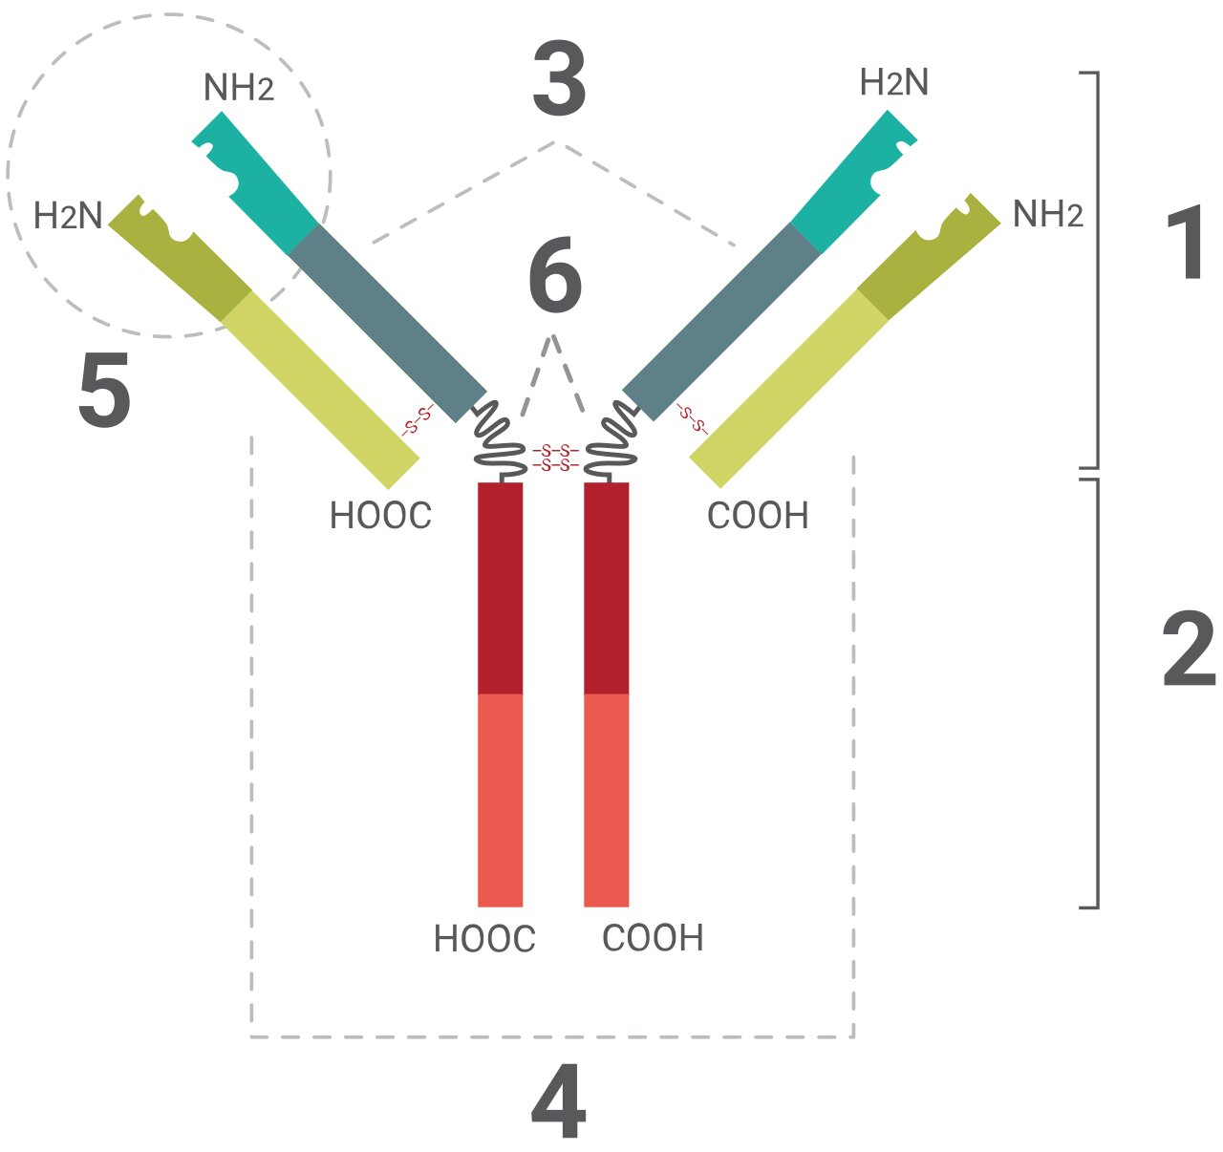
Avoidance of Host Defences
Fab region
Fc region
Heavy chain with one variable (V_{H}) domain followed by a constant domain (C_{H}1), a hinge region, and two more constant (C_{H}2 and C_{H}3) domains.
Light chain with one variable (V_{L}) and one constant (C_{L}) domain
Antigen binding site (paratope)
Hinge regions
2. Protein A
Protein A is a surface protein of S aureus which binds immunoglobulin G molecules by the Fc region.
In serum, bacteria will bind IgG molecules the wrong way round by this non-immune mechanism.
In principle this will disrupt opsonization and phagocytosis.

Slide 15
Avoidance of Host Defences
3. Leukocidin
S aureus can express a toxin that specifically acts on polymorphonuclear leukocytes.
Phagocytosis is an important defense against staphylococcal infection so leukocidin should be a virulence factor.
Damage to the Host
S aureus can express several different types of protein toxins which are probably responsible for symptoms during infections. Some damage the membranes of erythrocytes, causing hemolysis.
The leukocidin causes membrane damage to leukocytes.
Systemic release of α-toxin causes septic shock, while enterotoxins and TSST-1 cause toxic shock.

Slide 16
Membrane Damaging Toxins
(a) α-toxin
The best characterized and most potent membrane-damaging toxin of S aureus is α-toxin.
It is expressed as a monomer that binds to the membrane of susceptible cells.
Subunits then oligomerize to form hexameric rings with a central pore through which cellular contents leak.
Susceptible cells have a specific receptor for α-toxin which allows low concentrations of toxin to bind, causing small pores through which monovalent cations can pass.
At higher concentrations, the toxin reacts non-specifically with membrane lipids, causing larger pores through which divalent cations and small molecules can pass.

Slide 17
Membrane Damaging Toxins
α-toxin (con’t)
In humans, platelets and monocytes are particularly sensitive to α-toxin.
They carry high affinity sites which allow toxin to bind at concentrations that are physiologically relevant.
A complex series of secondary reactions ensue, causing release of eicosanoids and cytokines which trigger production of inflammatory mediators.
These events cause the symptoms of septic shock that occur during severe infections caused by S aureus.

Slide 18
Membrane Damaging Toxins
(b) β-toxin
β-toxin is a sphingomyelinase which damages membranes rich in this lipid.
In contrast the majority of isolates from bovine mastitis express β-toxin, suggesting that the toxin is important in the pathogenesis of mastitis.
This is supported by the fact that β-toxin-deficient mutants have reduced virulence in a mouse model for mastitis.
(c) δ-toxin
The δ-toxin is a very small peptide toxin produced by most strains of S aureus.
It is also produced by S epidermidis and S lugdunensis. The role of δ-toxin in disease is unknown.

Slide 19
Membrane Damaging Toxins
(d) γ-toxin and leukocidin
The gamma-hemolysin and leukocidin toxins, which function as two component toxins in the disruption and lysis of erythrocytes and leukocytes.

Slide 20
Superantigens: enterotoxins and toxic shock syndrome toxin
S aureus can express two different types of toxin with superantigen activity, enterotoxins, of which there are six serotypes (A, B, C, D, E and G) and toxic shock syndrome toxin (TSST-1).
Enterotoxins cause diarrhea and vomiting when ingested and are responsible for staphylococcal food poisoning.
When expressed systemically, enterotoxins can cause toxic shock syndrome (TSS) .
TSST-1 is responsible for 75% of TSS, including all menstrual cases.
TSS can occur as a sequel to any staphylococcal infection if an enterotoxin or TSST-1 is released systemically and the host lacks appropriate neutralizing antibodies.

Slide 21
Epidermolytic (exfoliative) toxin (ET)
This toxin causes the scalded skin syndrome in neonates, with widespread blistering and loss of the epidermis.
There are two antigenically distinct forms of the toxin, ETA and ETB.
There is evidence that these toxins have protease activity.
Both toxins have a sequence similarity with the S aureus serine protease, and the three most important amino acids in the active site of the protease are conserved.
It is not clear how the latter causes epidermal splitting.
It is possible that the toxins target a very specific protein which is involved in maintaining the integrity of the epidermis.

Slide 22
Other Extracellular Proteins
Coagulase
Coagulase is not an enzyme.
It is an extracellular protein which binds to prothrombin in the host to form a complex called staphylothrombin.
The protease activity characteristic of thrombin is activated in the complex, resulting in the conversion of fibrinogen to fibrin.
Coagulase is a traditional marker for identifying S aureus in the clinical microbiology laboratory.
Coagulase is regarded as an extracellular protein, a small fraction is tightly bound on the bacterial cell surface where it can react with prothrombin.
Finally, it has recently been shown that the coagulase can bind fibrinogen as well as thrombin, at least when it is extracellular.

Slide 23
Other Extracellular Proteins
Staphylokinase
(SAK; also known as staphylococcal fibrinolysin or Müller's factor)
Many strains of S aureus express a plasminogen activator called staphylokinase.
The genetic determinant is associated with lysogenic bacteriophages.
A complex formed between staphylokinase and plasminogen activates plasmin-like proteolytic activity which causes dissolution of fibrin clots.

Slide 24
Resistance and virulence of staphylococci
Enzymes
Catalase
Coagulase
Hemolysins
Hyaluronidase
Lipase
Penicillinase
Toxins
Superantigens: can activate large numbers of T cells, resulting in the massive release of cytokines
Toxic shock syndrome toxin 1 (TSST-1)
Enterotoxin B (heat stable)
Exfoliative toxin (causes epidermolysis )
Leukocidin (causes necrosis of the skin and mucous membranes)

Slide 25
Proteins
Clumping factor A: binds to fibrinogen → platelet activation, aggregation, and blood clumping
Protein A: inhibits phagocytosis and complement fixation by binding to the Fc region of IgG
Modified penicillin-binding protein (PBP) in MRSA
Capsular polysaccharides: promote colonization and persistence in host tissues

Slide 26
Subtypes and variants
Skin
Impetigo
Folliculitis, boils and carbuncle
Abscess
Empyema
Wound infections
Pyomyositis
Postpartum mastitis
Ear, nose, and throat
Otitis media
Sinusitis
Parotitis
Mastoiditis
Lymphatic system
Lymphadenopathy
Systemic infections
Endocarditis
Osteomyelitis
Pneumonia
Meningitis
Sepsis

Slide 27
Staph frequently causes localized skin infections, such as:
Infected hair follicles (folliculitis)
Boils (furuncles)
Impetigo
Staph can also cause abscesses and spread to:
Bones (osteomyelitis)
Lungs (pneumonia)
Blood (bacteremia or sepsis)
Heart (endocarditis)

Slide 28
DIAGNOSIS
S. aureus infection is diagnosed by isolating the organism in culture specimens of blood, tissue, or pus.
Non–culture-based methods, such as nucleic acid amplification tests, are becoming available, but their utility is still being defined.
Culture remains the “gold standard.”
Gram stain is useful for making a presumptive diagnosis of staphylococcal infection.

